Slide 1
Effect of Biochar on Plant Growth
Brandon Kim
STAT 183

Slide 2
Project Outline
Research Objective
Model Diagnostics
Data Analysis
Conclusion

Slide 3
Research Objective
Objective: In this project, we want to test the effects of three main factors (Biochar treatment, wheat varieties, and soil types) on their effects on plant growth.
Variables of Interest: Responses – Plant Growth (shoot weight, shallow root weight, deep root weight, total root weight, and root-shoot ratio)
Predictors – Biochar Treatment (present or absent), wheat varieties (76 or 1RS), and soil types (soil or soil-sand)
Model:
2³ Factorial Design for all 5 responses (backward elimination)

Slide 4
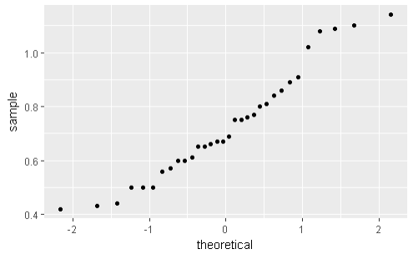
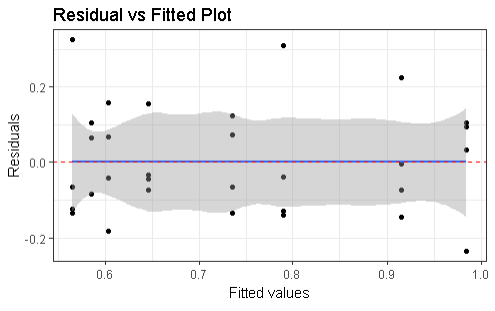

Model Diagnostics – Shallow Root Weight
Normality

Slide 5
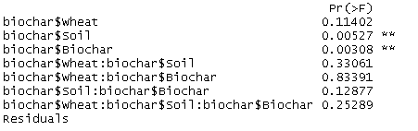


ANOVA – Backward Elimination
Full Model
Reduced Model

Slide 6
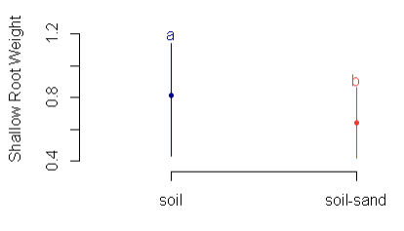
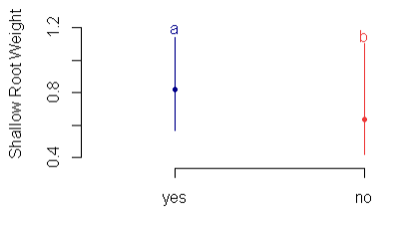
Comparison of Means
Differences in means for significant effects (Soil type and Biochar)
Confidence Intervals

Slide 7
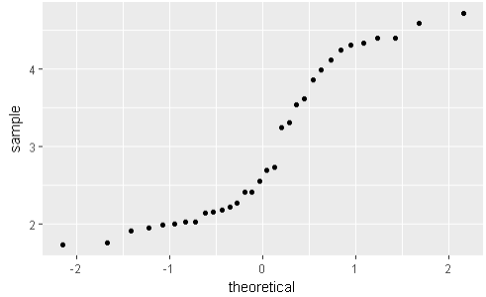
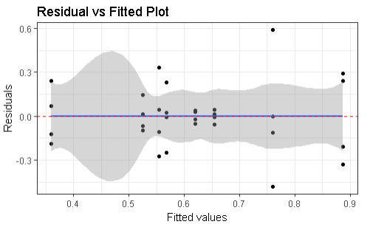

Model Diagnostics – Deep Root Weight
Normality

Slide 8
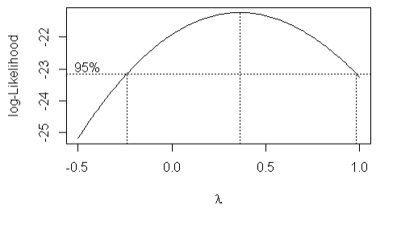
Model Diagnostics – Box-Cox
Since 0.5 is contained in the 95% Confidence Interval for λ , we will apply a log transformation.

Slide 9
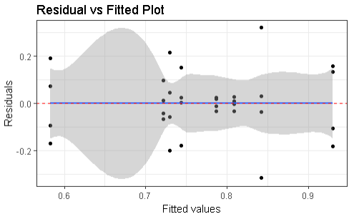
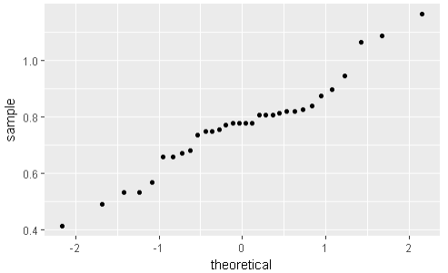

Model Diagnostics – Transformed Data
Normality

Slide 10
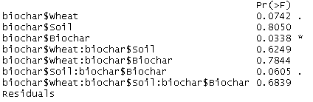


ANOVA – Backward Elimination
Full Model
Reduced Model

Slide 11
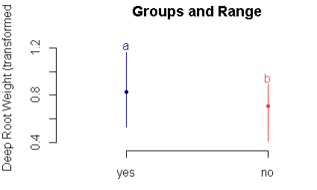
Comparison of Means
Differences in means for significant effects (Biochar)
Confidence Intervals

Slide 12
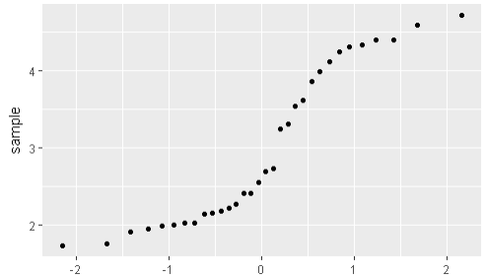
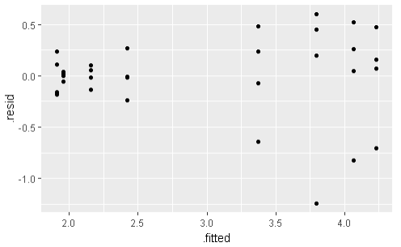
Model Diagnostics – Shoot Weight
Normality

Slide 13
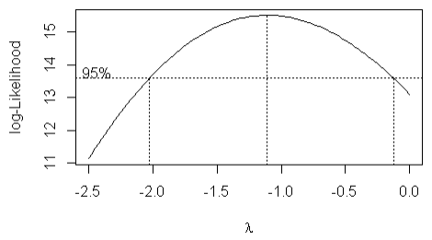
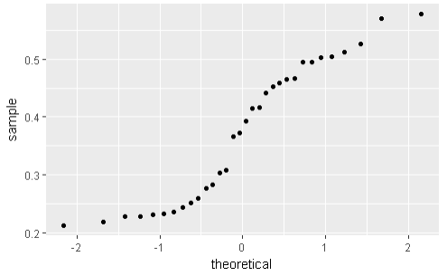
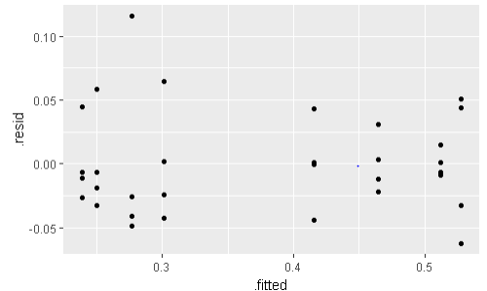
Model Diagnostics – Box-Cox
Since -1 is contained in the 95% Confidence Interval for λ , we will apply an inverse transformation.

Slide 14
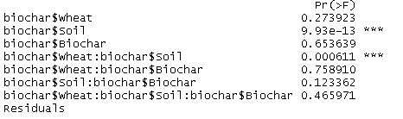


ANOVA – Backward Elimination
Full Model
Reduced Model

Slide 15
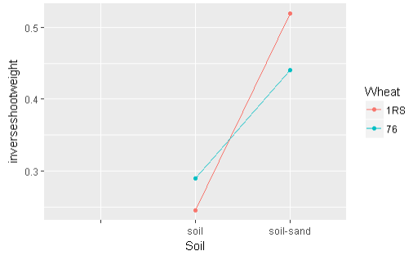
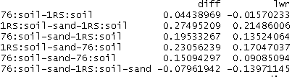
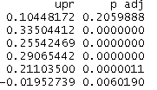
Comparison of Means
Interaction Plot (Wheat*Soil):
Combination of Soil type (soil-sand) and Wheat type (1RS) yielded the highest growth in shoot weight.
Combination of Soil type (soil) and Wheat type (1RS) yielded the lowest growth in shoot weight.
Confidence Intervals

Slide 16
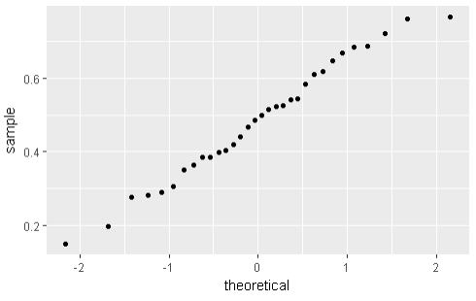
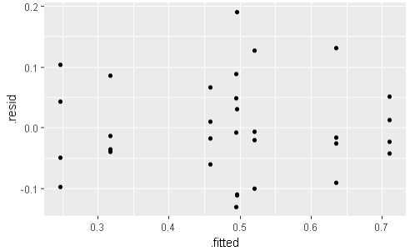

Model Diagnostics – Root-Shoot Ratio
Normality

Slide 17
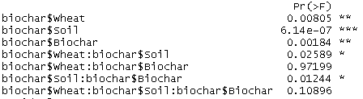
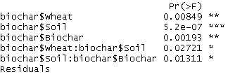
ANOVA – Backward Elimination
Full Model
Reduced Model

Slide 18
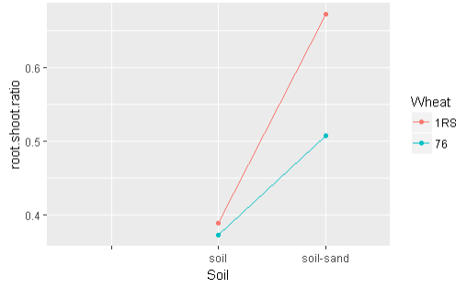
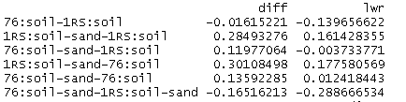
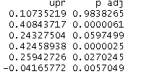
Comparison of Means
Interaction Plot (Wheat*Soil):
Combination of Soil type (soil-sand) and Wheat type (1RS) yielded the highest growth in root-shoot ratio.
Combination of Soil type (soil) and Wheat type (76) yielded the lowest growth in root-shoot ratio.
Confidence Intervals

Slide 19
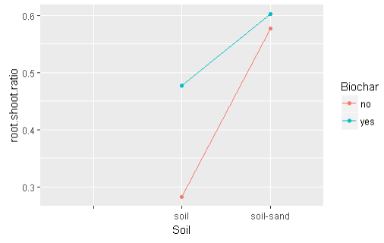
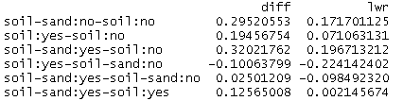
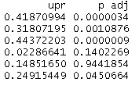
Comparison of Means
Interaction Plot (Soil*Biochar):
Combination of Soil type (soil-sand) and Biochar (present) yielded the highest growth in root-shoot ratio.
Combination of Soil type (soil) and Biochar (missing) yielded the lowest growth in root-shoot ratio.
Confidence Intervals

Slide 20
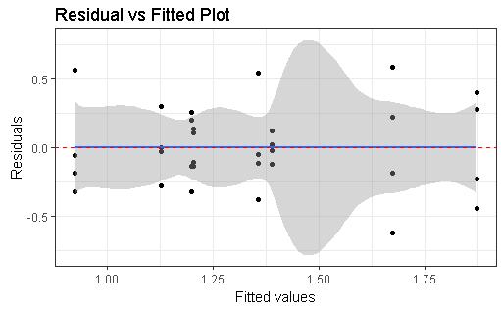
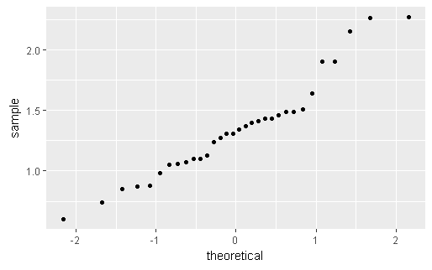

Model Diagnostics – Total Root Weight
Normality

Slide 21
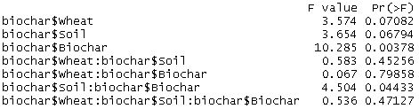

ANOVA – Backward Elimination
Full Model
Reduced Model

Slide 22
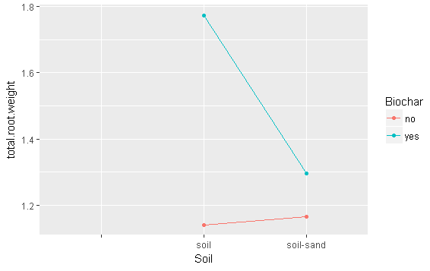
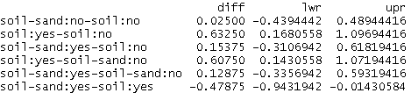

Comparison of Means
Interactions Plot (Soil*Biochar):
Combination of Soil type (soil) and Biochar (present) yielded the highest growth in total root weight.
Combination of Soil type (soil) and Biochar (missing) yielded the lowest growth in total root weight.

Slide 23
Conclusion
Main Goal: Maximize plant growth with different factors (soil type, wheat, biochar treatment).
If we want to maximize growth in a plant’s shallow root weight, we want to utilize the soil type and biochar treatments (interaction negligible). The best result for shallow root weight will result with the regular soil type or the use of the biochar treatment.
If we want to maximize growth in a plant’s deep root weight, we will only utilize the biochar treatment. The use of biochar treatment will contribute to a larger growth in deep root weight.
If we want to maximize growth in a plant’s shoot weight, we want to consider the interaction between wheat and soil type. The best interaction combination for maximizing shoot weight will result from using soil-sand and the 1RS wheat variety. If were focused on the regular soil type, wheat variety did not yield significantly different average shoot weights.

Slide 24
Conclusion
Main Goal: Maximize plant growth with different factors (soil type, wheat, biochar treatment).
If we want to maximize growth in a plant’s root-shoot ratio, we want to consider both the interaction between wheat with soil and soil with biochar treatment. The best result for this ratio will result with using soil-sand with 1RS wheat type. If we focus in on the regular soil type, the use of biochar treatment will not yield significantly different ratios.
If we want to maximize the plant’s total root weight, we need to consider the interaction of soil type with the use of biochar treatment. The highest growth in total root weight will result from the use of regular soil with the biochar treatment. If we focus in on soil-sand typing, the use of biochar treatment did not make a statistical difference in total root weight.

